Slide 1

Chapter 3.2 Review-based Recommendation

Slide 2
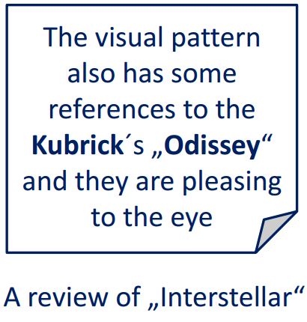
User Reviews
More expressive than ratings (multi-faceted users’ opinions)
May reveal connections among items
May increase the diversity and novelty of recommendations

Slide 3
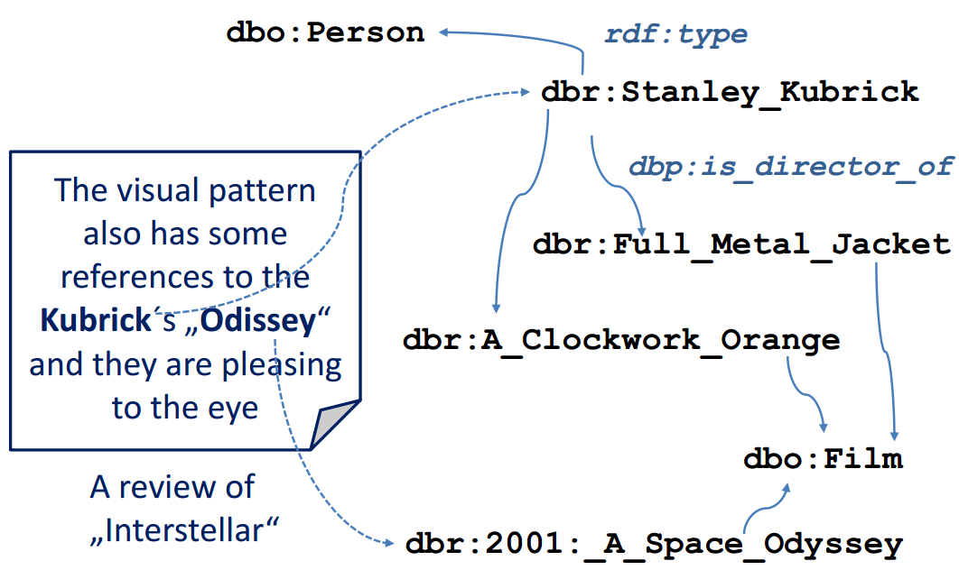
Annotation & Discovering Entites
Notes:
Iacopo Vagliano, Diego Monti, Ansgar Scherp, Maurizio Morisio, Content Recommendation through Semantic Annotation of User Reviews and Linked Data - An Extended Technical Report, 9th International Conference on Knowledge Capture, 2017.
https://arxiv.org/abs/1709.09973

Slide 4
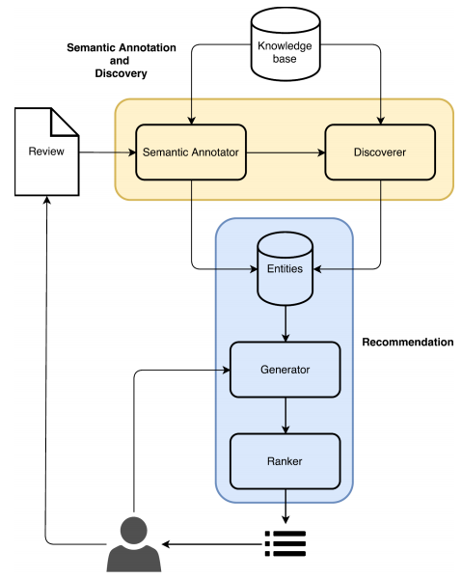
SemRevRec
Annotated and discovery entities feeding
Generation of candidate recommendations and ranking
Independence from the knowledge base
Notes:
https://arxiv.org/abs/1709.09973

Slide 5
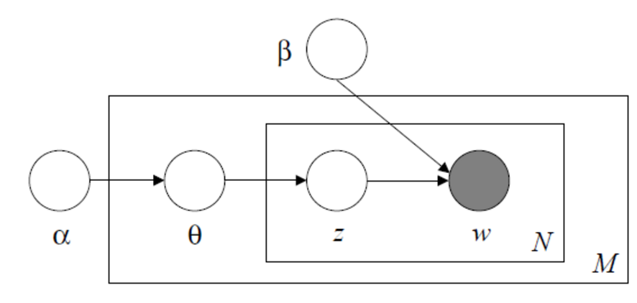
LDA: Latent Dirichlet Allocation
Basic Idea
each topic is characterized by a distribution over words
documents are represented as random mixtures over latent topics

Slide 6

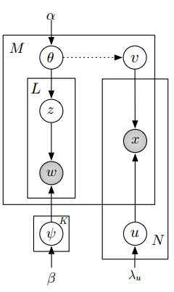


HFT: Hidden Factors as Topics
$$θ→v$$

Slide 7
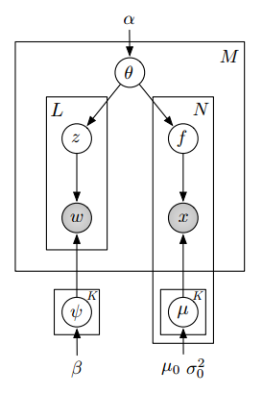
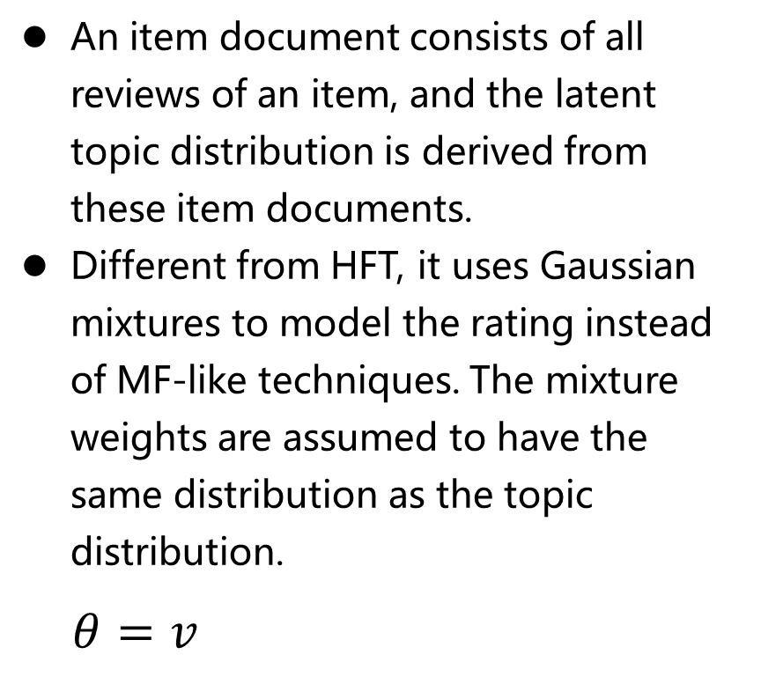
RMR: Rating Meets Review
An item document consists of all reviews of an item, and the latent topic distribution is derived from these item documents.
Different from HFT, it uses Gaussian mixtures to model the rating instead of MF-like techniques. The mixture weights are assumed to have the same distribution as the topic distribution.
$θ=v$

Slide 8
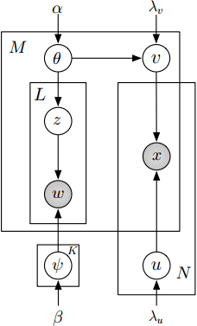
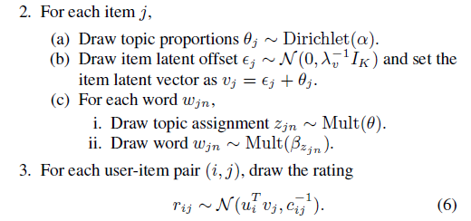

CTR: Collaborative Topic Regression
$$θ+ε=v$$
Wang C, Blei D M. Collaborative topic modeling for recommending scientific articles[C], KDD 2011: 448-456.

Slide 9
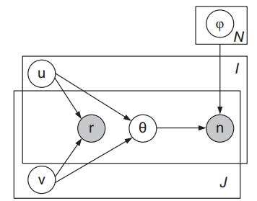


TopicMF
Yang Bao, Hui Fang, Jie Zhang, TopicMF: Simultaneously exploiting ratings and reviews for recommendation[C], AAAI 2014.
Notes:
NOTE: HFT learns the topics for each item, while TopicMF learns the topics for each review.

Slide 10
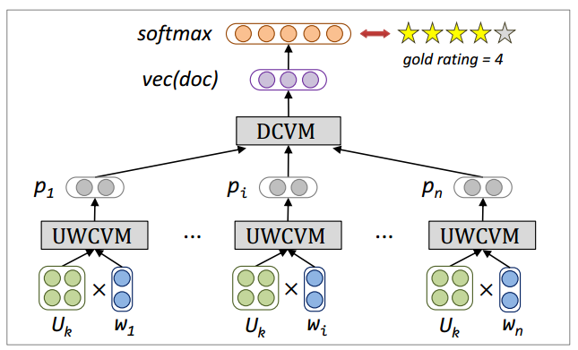
UWRL = UWCVM + DCVM
Tang et al., User Modeling with Neural Network for Review Rating Prediction, IJCAI 2015.

Slide 11
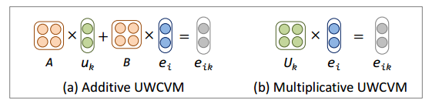

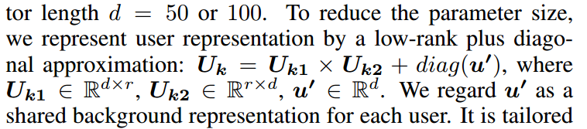
UWCVM: User-Word Composition Vector Model
The second model (b) meets the needs of user modifying word meaning.

Slide 12

DCVM: Document Composition Vector Model
We first use biTanh to calculate the vector for each sentence by regarding the user-modified word vectors as input.
We then feed the sentence vectors to biTanh for generating the document vector vec(doc).
Essentially, the recursive use of biTanh can be viewed as two pairs of bag-of-word convolutional neural network, whose window size is two and parameters are clamped as addition and tanh.

Slide 13
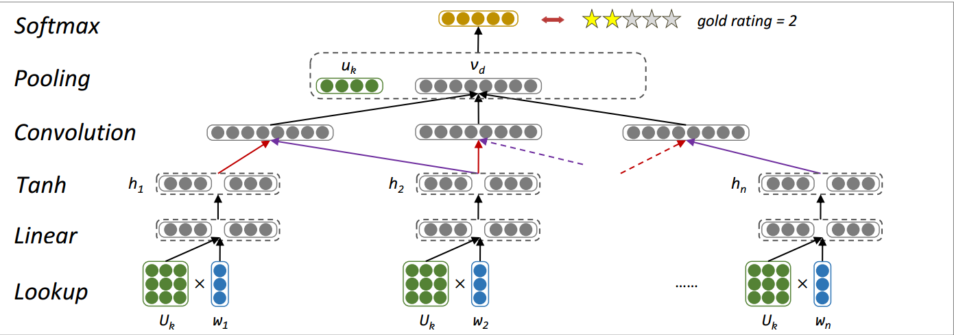
UWRL in IJCAI 2015

Slide 14
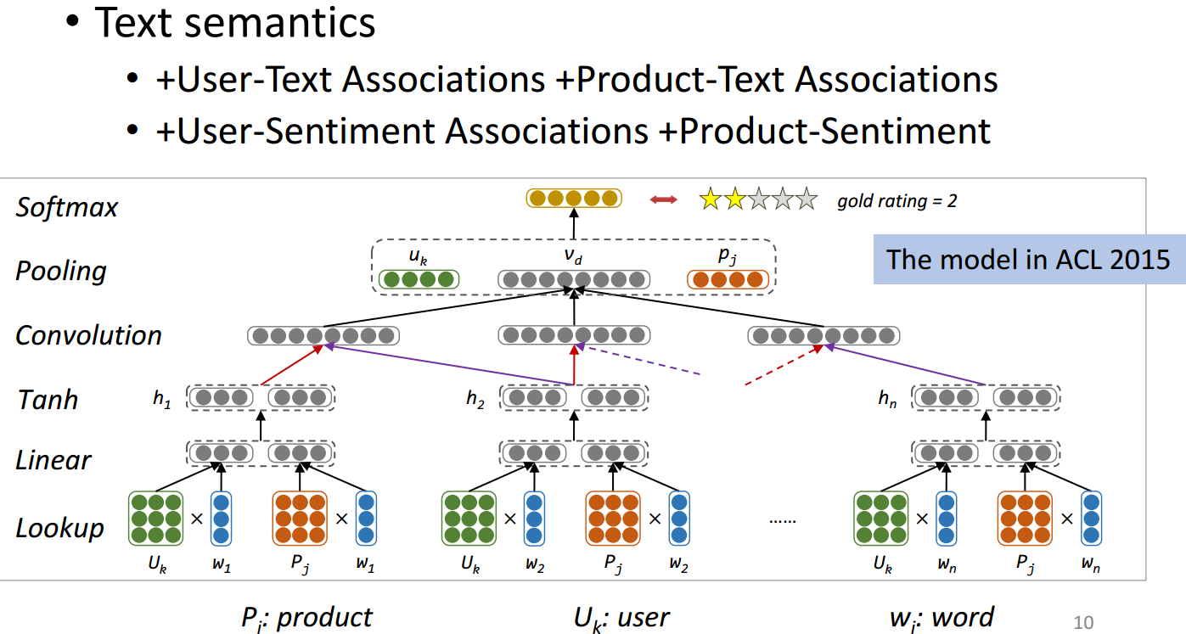
UWRL in ACL 2015
Tang et al., Learning Semantic Representations of Users and Products for Document Level
Sentiment Classification, ACL 2015.

Slide 15
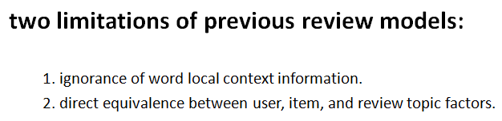
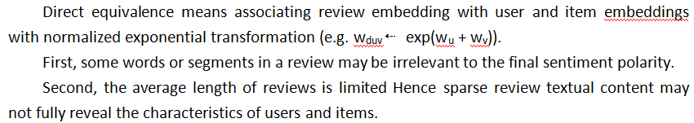
CMLE: Collaborative Multi-Level Embedding
Zhang et al., Collaborative Multi-Level Embedding Learning from Reviews for Rating Prediction, IJCAI 2016

Slide 16
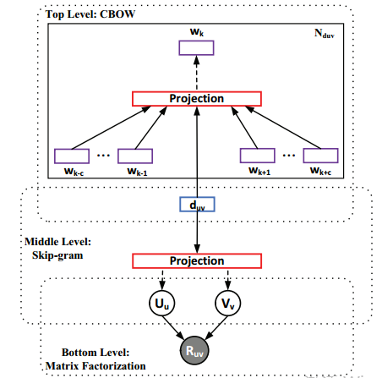
CMLE: Collaborative Multi-Level Embedding

Slide 17
Conformity Modeling
Motivation
When making choices online, users are normally influenced by others’ opinions
E.g., when a user rates a 4-star movie (public opinion), even if he thinks it only worth 2-star (truthful opinion), he might still rate it as 3-star (biased opinion) due to conformity.

Slide 18
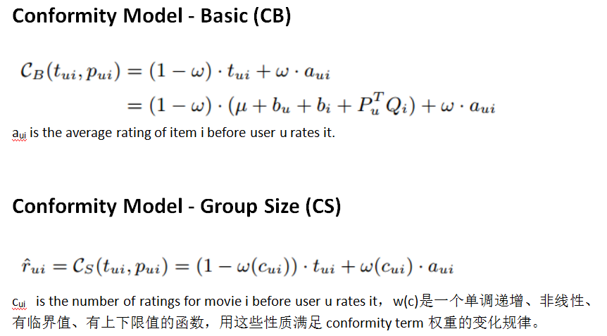
Conformity Modeling

Slide 19
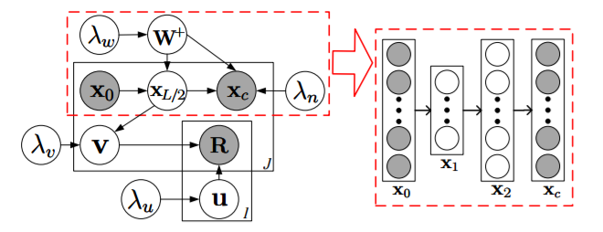
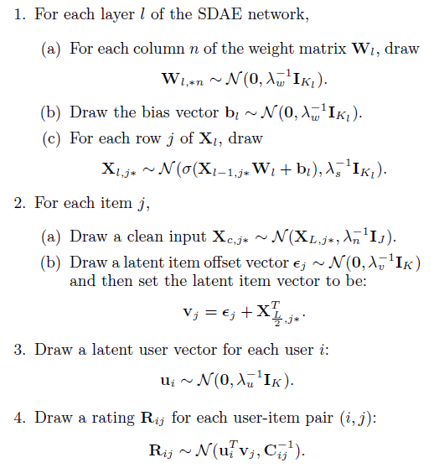
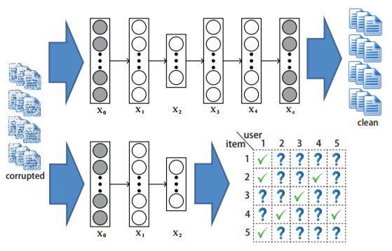
CDL: Collaborative Deep Learning
Wang H et al., Collaborative deep learning for recommender systems, KDD 2015,1235-1244.
Notes:
However, the content information is only extracted from bag-of-words representations, which does not take into account word orders and context that are important for extracting semantic meanings.

Slide 20
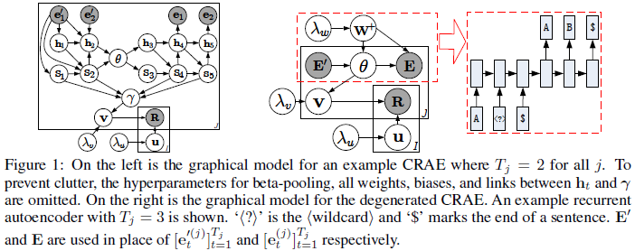
CRAE: Collaborative Recurrent AutoEncoder
Wang H et al., Collaborative Recurrent AutoEncoder: Recommend while Learning to Fill in the Blanks, NIPS 2016.

Slide 21



EFM: Explicit Factor Models
User-Feature Attention Matrix X
Item-Feature Quality Matrix Y
P=[U1 H1] Q=[U2 H2], where H1、H2 are user- and item-implicit Feature Matrix
Yongfeng Zhang et al., Explicit Factor Models for Explainable Recommendation based on Phrase-level Sentiment Analysis, SIGIR 2016
Notes:
Basic Idea:评论信息中蕴含着用户对商品某种属性的情感态度，可以从中提取出用户和商品的显式特征（Explicit Feature），将其与矩阵分解模型的隐式特征结合，可以进一步提升推荐系统的性能以及可解释性。

Slide 22
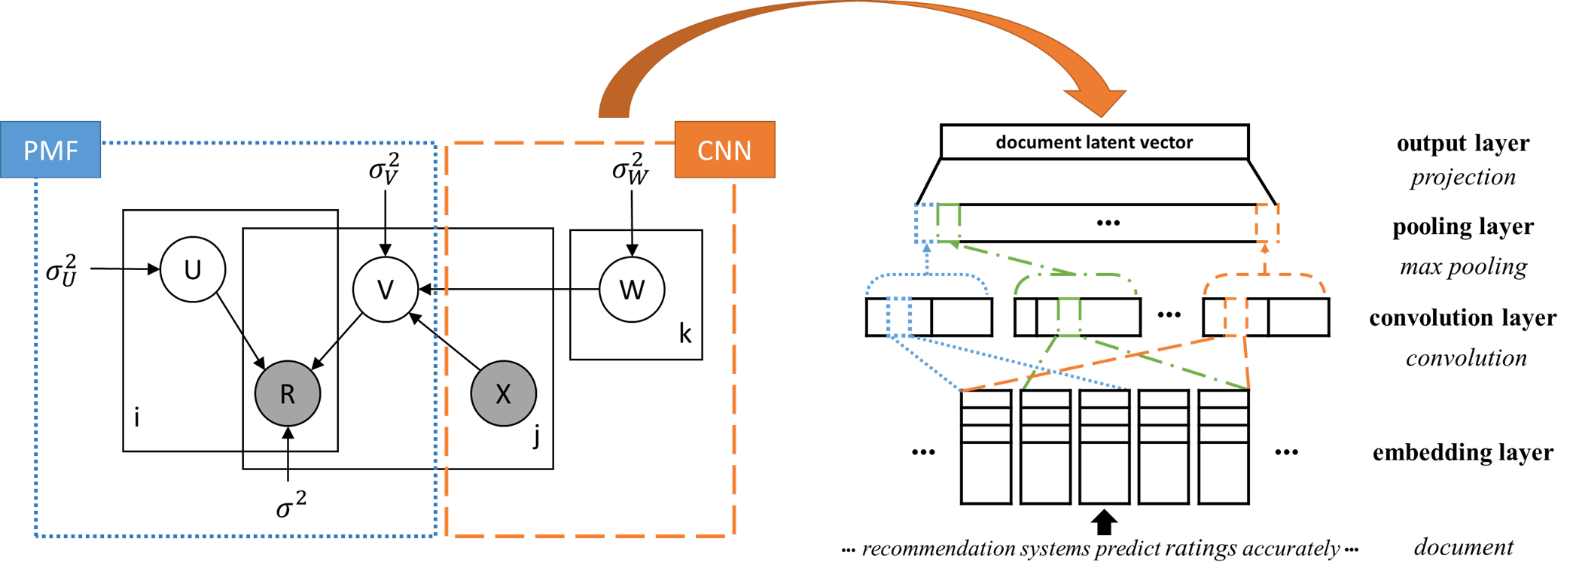
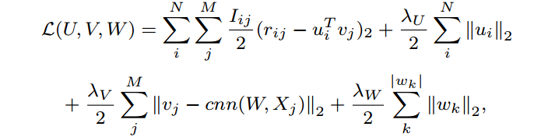
ConvMF: MF with CNN
Donghyun Kim et al., Convolutional Matrix Factorization for Document Context-Aware Recommendation, RecSys 2016
Notes:
CNN is used to capture contextual features in item review text for rating prediction.

Slide 23
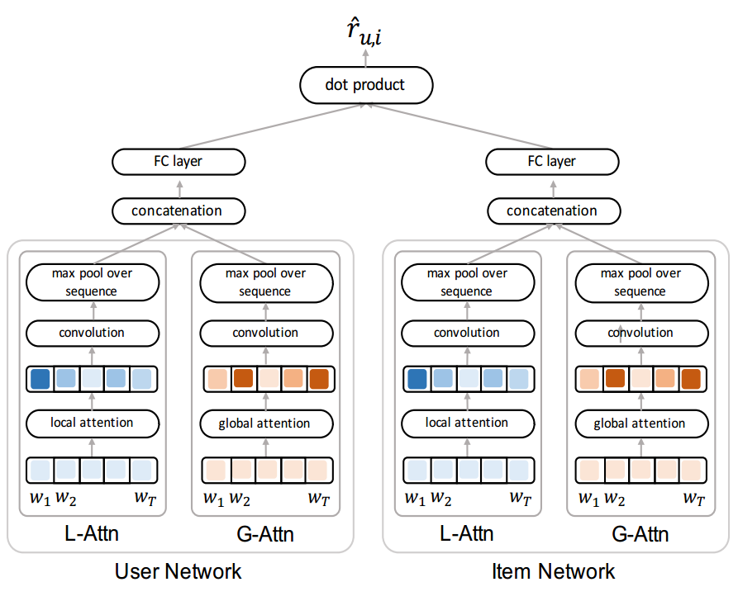
D-Attn: local & global attention
Interpretable Convolutional Neural Networks with Dual Local and Global Attention for Review Rating Prediction, RecSys 2017.
Notes:
A big advantage of attention is that it gives us the ability to interpret and visualize what the model is doing.

